Slide 1


PRESENTED BY
L.SeshaSai (VTU 26580)(23UECS0307)
J.PrudhviRaj (VTU 25575)(23UECS0231)
V.Abhilash (VTU25558)(23UECS1183)
SUPERVISED BY
Dr.N.Krishnaveni

Slide 2
Design & development of a Smart Rock Weathering & Patina Formation Observation System
AGENDA
Introduction
Literature Survey
Problem Statement
Proposed Methodology
Proposed System Architecture
Implementation Details
Testing & Validation
Preliminary Results & Analysis
Conclusion and Future Work
References

Slide 3
Introduction
Problem Statement:
Rock weathering and patina formation occur slowly over time due to environmental factors such as temperature, humidity, rainfall, sunlight, and air pollution. Traditional observation methods rely on manual inspection, which is time-consuming, inaccurate, and lacks continuous monitoring. There is a need for a smart automated system that can continuously observe environmental conditions and track changes in rock surfaces to better understand weathering and patina formation.
Project Goal:To design and develop a smart observation system that monitors environmental parameters and captures rock surface changes over time using sensors and camera modules. The system will collect, store, and analyze data to study weathering and patina formation automatically and provide visual and graphical insights.
Brief Overview: The Smart Rock Weathering & Patina Formation Observation System uses environmental sensors and a camera module connected to a microcontroller (ESP32/Arduino/Raspberry Pi). The system continuously records temperature, humidity, light intensity, and other weather parameters while capturing periodic images of rock surfaces. The collected data is transmitted to a cloud platform where it is stored and analyzed. A dashboard displays environmental trends and visual changes in rock surfaces, helping researchers observe weathering and patina formation over time.

Slide 4
Literature Survey
Existing Systems and Related Works:
• Existing systems use IoT-based environmental monitoring to measure temperature, humidity, rainfall, and light intensity. • Wireless sensor networks are used for monitoring environmental and geological changes. • Some studies use image processing techniques to analyze rock surface color and texture changes. • Laboratory-based weathering experiments are used to study patina formation under controlled conditions. • Cloud-based monitoring systems store and analyze environmental data in real time.
Limitations of Existing Systems
• No continuous rock surface monitoring • Manual observation required • High-cost laboratory equipment • No real-time patina tracking • Lack of integrated smart system
Proposed System Motivation
• Combines sensors and camera • Real-time monitoring • Automated data collection • Cloud-based analysis • Low-cost smart observation system

Slide 5
Problem Statement
Rock weathering and patina formation occur gradually due to environmental factors such as temperature, humidity, rainfall, and sunlight. Existing observation methods rely on manual inspection, which is time-consuming and lacks continuous monitoring. These methods do not provide accurate tracking of surface changes over time. Therefore, a smart automated system is required to monitor environmental conditions and observe rock weathering in real time.
Limitations of Existing Solutions
• Existing methods rely on manual observation, which is time-consuming and requires continuous human involvement to monitor rock weathering and patina formation.
• Most systems focus only on measuring environmental parameters such as temperature and humidity without tracking actual changes in rock surface appearance.
• Laboratory-based weathering analysis requires expensive equipment and controlled conditions, making it unsuitable for real-time outdoor monitoring.
• There is no continuous monitoring system to observe gradual weathering and patina formation over a long period of time.

Slide 6
Proposed Methodology
• Environmental sensors such as temperature, humidity, and light sensors are used to continuously monitor surrounding weather conditions affecting rock weathering.
• A camera module is installed to capture periodic images of the rock surface for observing patina formation and texture changes over time.
• The sensor data and captured images are processed using a microcontroller such as Arduino, ESP32, or Raspberry Pi.
• The collected data is transmitted to a cloud platform or local storage for continuous data logging and monitoring.
• Image comparison and data analysis techniques are used to identify gradual changes in rock surface and environmental impact.
• A dashboard is developed to visualize environmental parameters and rock surface changes for long-term observation and analysis.
• The system performs continuous monitoring at regular time intervals to ensure accurate tracking of gradual weathering and patina formation.
• Wireless communication such as Wi-Fi is used to enable remote monitoring and access to collected data from any location.
• The proposed system provides automated alerts and graphical visualization to help users easily analyze long-term rock surface changes.

Slide 7
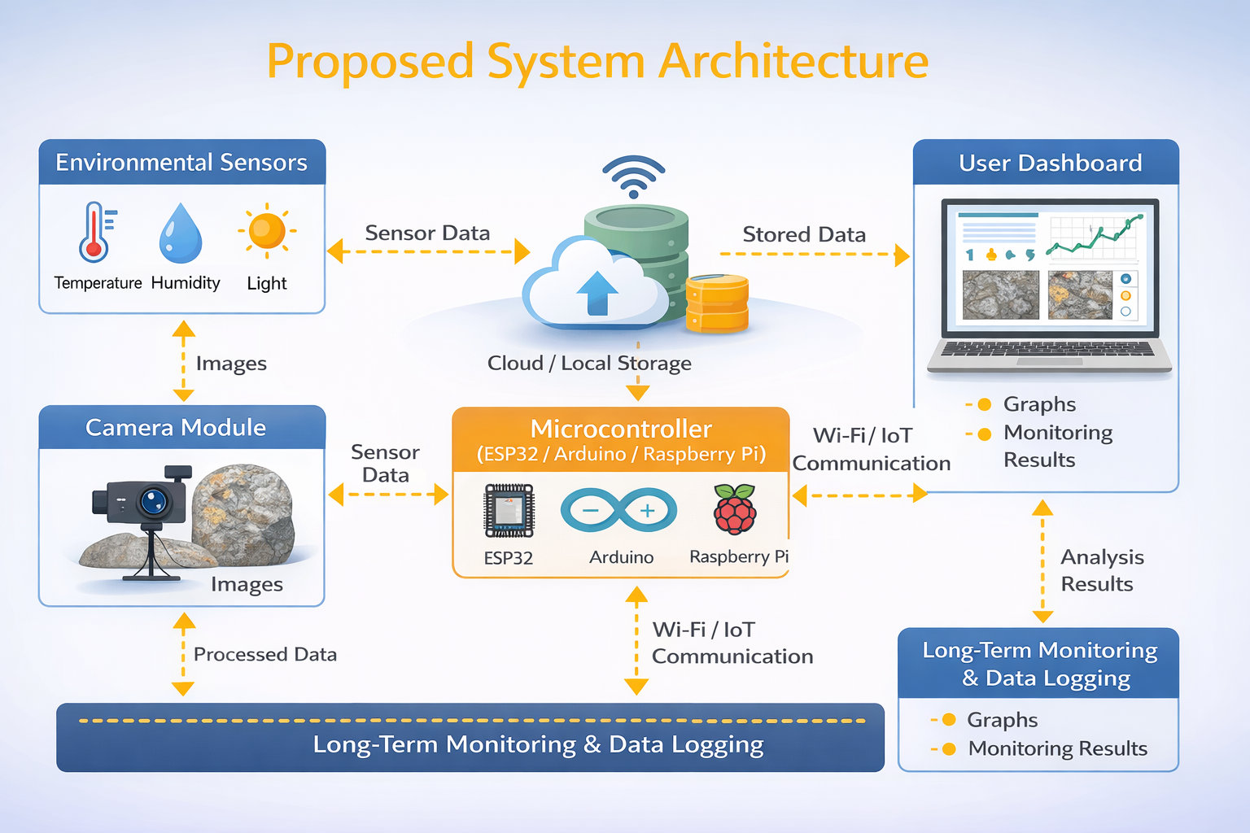
Proposed System Architecture

Slide 8
Summary of Module -1
• Module-1 focuses on collecting environmental parameters such as temperature, humidity, and light intensity that influence rock weathering and patina formation.
• Environmental sensors continuously monitor surrounding weather conditions and provide real-time data for analysis.
• A camera module is used to capture periodic images of the rock surface to observe gradual changes in color and texture.
• The collected sensor data and captured images are transmitted to the microcontroller for processing.
• This module performs continuous monitoring and data acquisition for weathering observation.
• The gathered data serves as input for further analysis and long-term rock surface monitoring.
• The module ensures continuous data collection at regular time intervals to improve accuracy in monitoring weathering conditions.
• The system supports real-time monitoring of environmental factors affecting rock surface changes.
• The collected data is prepared for transmission to storage and analysis modules for further processing.

Slide 9
Summary of Module -2
• Module-2 focuses on processing the collected sensor data and captured rock surface images using a microcontroller.
• The system filters and organizes environmental data such as temperature, humidity, and light intensity for further analysis.
• Captured images are stored and prepared for comparison to detect gradual rock surface changes.
• The processed data is transmitted to cloud storage or local database for long-term monitoring.
• Wireless communication such as Wi-Fi is used to enable remote data transfer and access.
• This module acts as an intermediate stage between data collection and final analysis.
• The module ensures reliable data transmission from the microcontroller to the storage system without data loss.
• It supports continuous operation for long-term monitoring of environmental conditions and rock surface images.
• The system organizes collected data based on time intervals for easy comparison and tracking.
• Module-2 prepares the processed data for visualization and analysis in the next stage.

Slide 10
Summary of Modules -3
• Module-3 focuses on analyzing the stored environmental data and captured rock surface images.
• Image comparison techniques are used to identify gradual changes in rock color, texture, and patina formation.
• The analyzed data is used to generate graphs and visual representations of environmental variations.
• A dashboard is developed to display monitoring results and rock surface changes over time.
• The system enables long-term comparison of data collected at different time intervals.
• This module provides final output and helps in understanding the impact of environmental conditions on rock weathering.
• The module performs automated analysis to detect gradual weathering and patina formation on rock surfaces.
• It provides graphical visualization and comparison of environmental data over time.
• The final results are displayed to the user for easy monitoring and interpretation of rock weathering changes.

Slide 11
Summary of Modules -4
• Module-4 focuses on displaying the analyzed data through a user-friendly dashboard interface. • The system presents environmental parameters such as temperature, humidity, and light intensity in graphical form. • Captured rock surface images are displayed for visual comparison over different time intervals. • The module enables real-time monitoring of rock weathering and patina formation. • Historical data is stored and used for long-term comparison and analysis. • The dashboard allows users to observe trends in environmental conditions affecting rocks. • Remote access is provided so users can monitor the system from any location. • The system generates alerts or notifications when significant changes are detected. • Module-4 provides final visualization and reporting for easy understanding of rock weathering behavior.

Slide 12
Implementation Details
Data Acquisition: Environmental sensors such as temperature, humidity, and light sensors are used to collect real-time data affecting rock weathering. A camera module captures periodic images of the rock surface. The collected data is acquired through a microcontroller and stored in cloud or local storage for further processing.
Data Preprocessing: The collected sensor data is filtered, organized, and formatted for analysis. Image preprocessing such as resizing, normalization, and noise removal is performed to improve comparison accuracy. The processed data is structured based on time intervals for easy tracking of rock surface changes.
Analysis Model / Processing: The system compares captured images over time to detect gradual changes in rock color, texture, and patina formation. Environmental data is analyzed using graphical visualization techniques. The processed results are stored and displayed on a dashboard for long-term monitoring and analysis.

Slide 13
Testing & Validation
Testing Methodology: The system is tested by collecting environmental sensor data and capturing rock surface images at regular intervals. The microcontroller functionality, data transmission, and storage modules are verified to ensure proper operation. The dashboard is tested to confirm correct visualization of environmental parameters and rock surface changes.
Test Cases: Test cases include verifying sensor readings accuracy, camera image capture at defined intervals, successful data transmission to cloud storage, and correct display of graphs and images on the dashboard. The system is also tested for continuous monitoring and long-term data logging.
Validation Metrics: The system performance is validated based on sensor accuracy, data transmission reliability, image comparison results, and dashboard visualization. Additional metrics include system response time, continuous monitoring capability, and successful detection of gradual rock weathering changes.

Slide 14
Preliminary Results & Analysis
Performance Metrics: The system successfully collected environmental parameters such as temperature, humidity, and light intensity at regular intervals. Rock surface images were captured continuously and stored for comparison. Data transmission to storage and dashboard visualization worked without interruption, ensuring reliable monitoring.
Qualitative Analysis: The observed results show gradual changes in rock surface color and texture under varying environmental conditions. Environmental data trends indicate the influence of humidity and temperature on patina formation. The system effectively identifies visible surface changes over time.
Model Accuracy / System Accuracy: The system achieved accurate sensor readings and reliable image capture during testing. Data logging and visualization provided consistent monitoring results. The overall system performance demonstrates effective tracking of rock weathering and patina formation.

Slide 15
Software & Hardware Requirements Specification
Software Requirements
• Programming Language: Python / Embedded C / Arduino IDE • Development Tools: Arduino IDE, VS Code, Raspberry Pi OS • IoT Platform: ThingSpeak / Firebase / Blynk • Operating System: Windows 10 or Linux • Image Processing: OpenCV (optional) • Database: Cloud Storage / Local Database
Hardware Requirements
• Microcontroller: ESP32 / Arduino / Raspberry Pi • Temperature & Humidity Sensor (DHT11/DHT22) • Light Sensor (LDR) • Camera Module • Wi-Fi Module (built-in ESP32 or ESP8266) • Power Supply • Connecting wires and breadboard

Slide 16
Conclusion and Future Work
Conclusion
• The Smart Rock Weathering & Patina Formation Observation System provides continuous monitoring of environmental conditions affecting rock surfaces. • The system successfully collects sensor data and captures images for analyzing weathering and patina formation. • Automated data logging and visualization help in long-term observation and comparison. • The proposed system reduces manual effort and improves monitoring accuracy. • The project offers a low-cost and efficient solution for studying rock weathering.
Future Work
• Integration of more sensors such as rainfall and pollution sensors • Implementation of advanced image processing techniques • Development of mobile application for remote monitoring • Use of machine learning for weathering prediction • Real-time alert system for significant rock surface changes

Slide 17
References
[1] M. Khan, M. S. Anwar and M. Othman, “An IoT-based weather monitoring system for environmental data analysis,” IEEE Internet of Things Journal, vol. 7, no. 3, pp. 1813-1822, Mar. 2020.
[2] S. Kumar and A. Jain, “IoT based weather monitoring system,” in Proc. IEEE 2nd Int. Conf. Electrical, Electronics and Computer Science (ICEECS), Bangalore, India, 2020, pp. 285-290.
[3] H.-S. Li, S. A. S. Srinivas Kumar and A. R. Singh, “Weather monitoring using IoT system,” in IEEE Int. Conf. Computing, Communication, Control and Automation, New Delhi, India, 2019, pp. 94-99.
[4] S. Stoyanov, Z. Kuzmanov and T. Stoyanova, “Weather Monitoring System Using IoT-based DIY Automatic Weather Station,” in Proc. 2024 IEEE Int. Conf. Energy Efficiency and Agricultural Engineering, 2024.
[5] D. S. Mavromatis, D. K. Mavromatis and C. A. Balanis, “Internet of Things (IoT)-based weather monitoring system,” IEEE Transactions on Industrial Informatics, vol. 16, no. 1, pp. 102-113, Jan. 2020.

Slide 18
THANK YOU

